Slide 1

Simulation Function For Linear regression
simulate_lineAr_regression(N_Row, N_var)

Slide 2
Objective
A function to simulate Linear Regression from user_input of N_row( no of rows) and N_var(no of columns)

Slide 3
What will you get from just one function:-
Summary of the Data
Univariate plots for each variable no matter what value of n_var is.
Correlation plot
Correlation summary
Linear Regression Model Summary

Slide 4
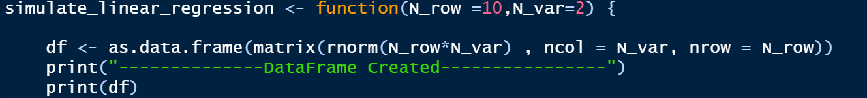
Defining a function with name
Simulate_linear_regression
Default Values for rows and columns
Creating a variable df which will store all the values with user defined N_row and N_var

Slide 5
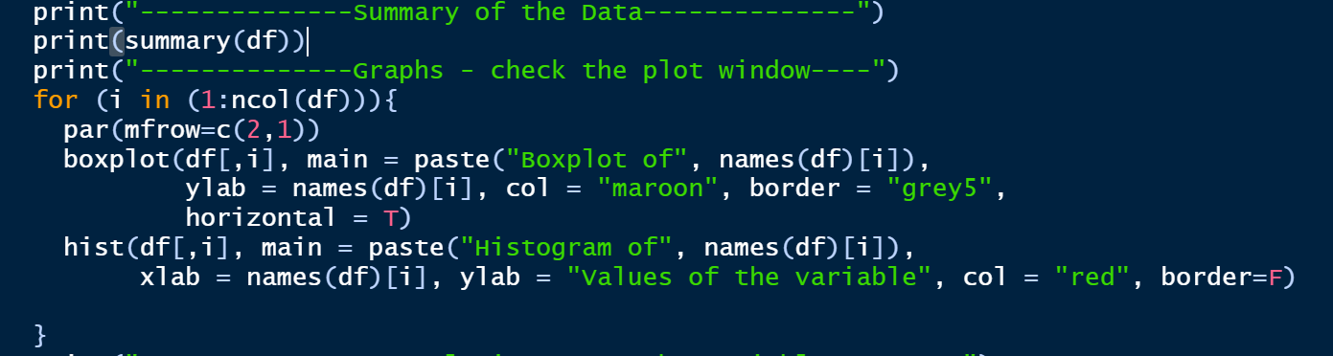
This loop will create hist and box plot for each variable be it 2 or 200 or N.
This will print summary of the data

Slide 6
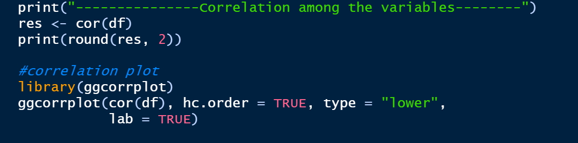
This will calculate correlation among variables
This will Plot correlation graph

Slide 7
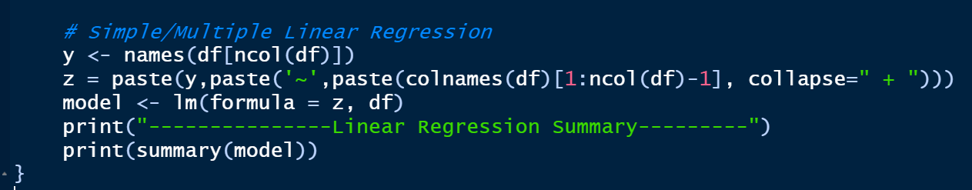
For iterating and collecting each variable in z in order to comply with the syntax of lm()
Linear Regression in R using lm() Function
Summary of LR Model

Slide 8
Output
From the function
simulate_linear_regression(10,2)

Slide 9
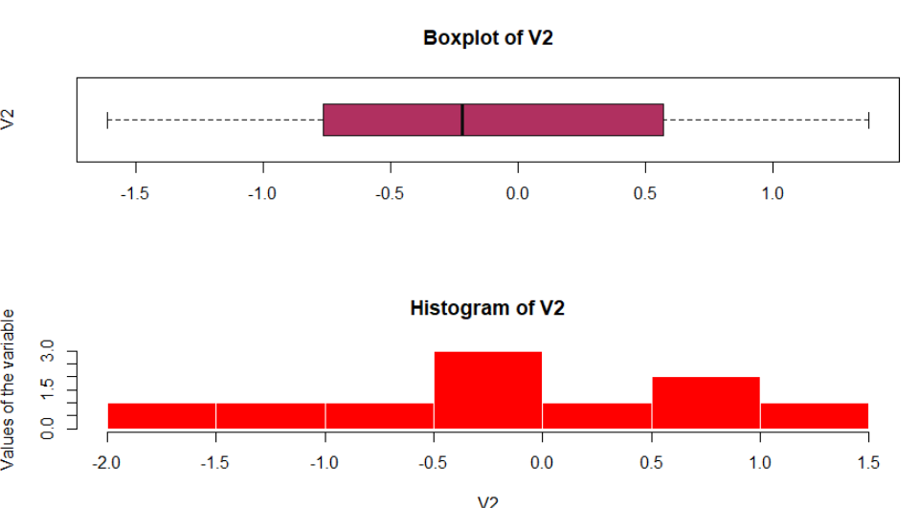
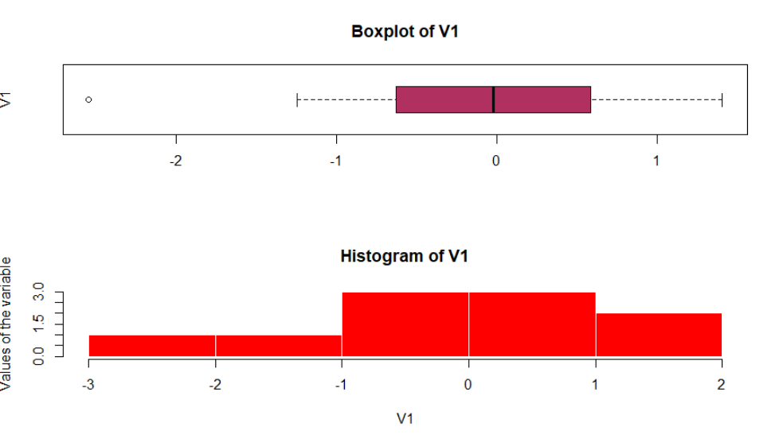
Box Plot and histogram of variables

Slide 10
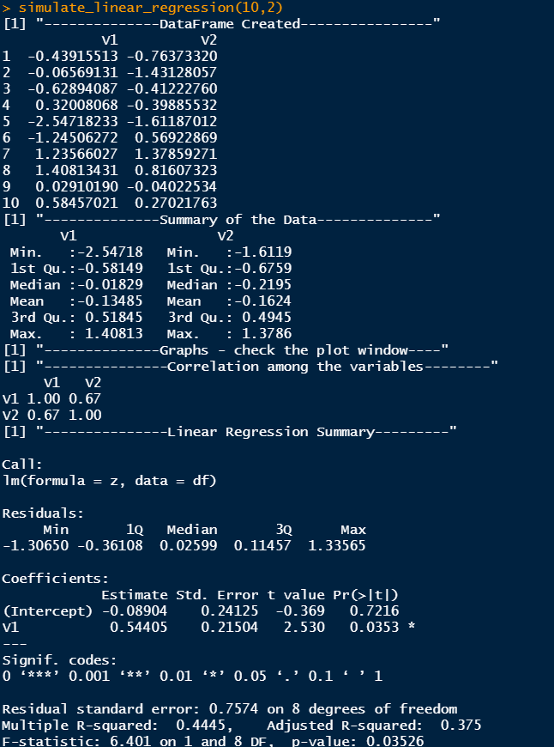
Dataframe created with 10 rows and 2 columns
Summary of the data created
Correlation of the dataframe
Summary of the regression Fit.

